Slide 1
CSC 593-Data Prototyping And Scientific Computing
Project Title: A life cycle assessment of plastic paver blocks
Sirri Neba Nforsoh

Slide 2
1- Introduction
Goal of the project
The goal of this project is to perform a life cycle assessment which evaluates the environmental impacts associated with the production and use of plastic paver blocks.
Identifying the environmental impact using the different impact indicators.
Identifying which processes have the highest impacts through out the LCA
Generalities
Plastic blocks are produced from waste plastics and sand and in some cases waste glass is used too.
Most the plastics used are collected from beaches and from plastic waste collection plants

Slide 3
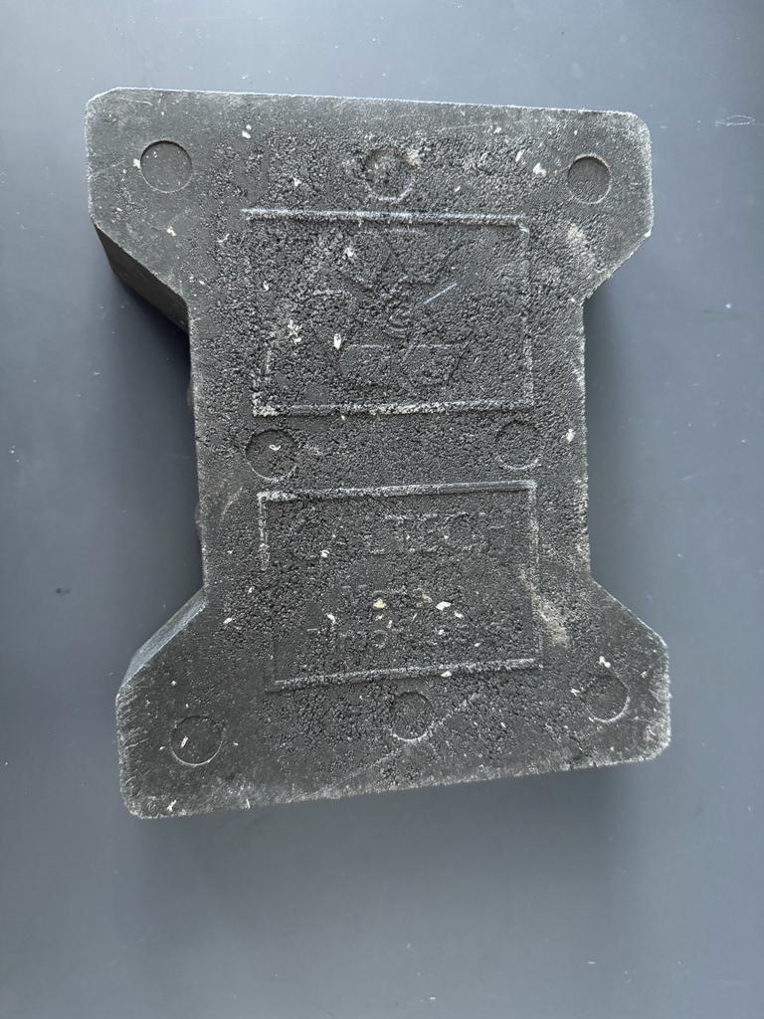
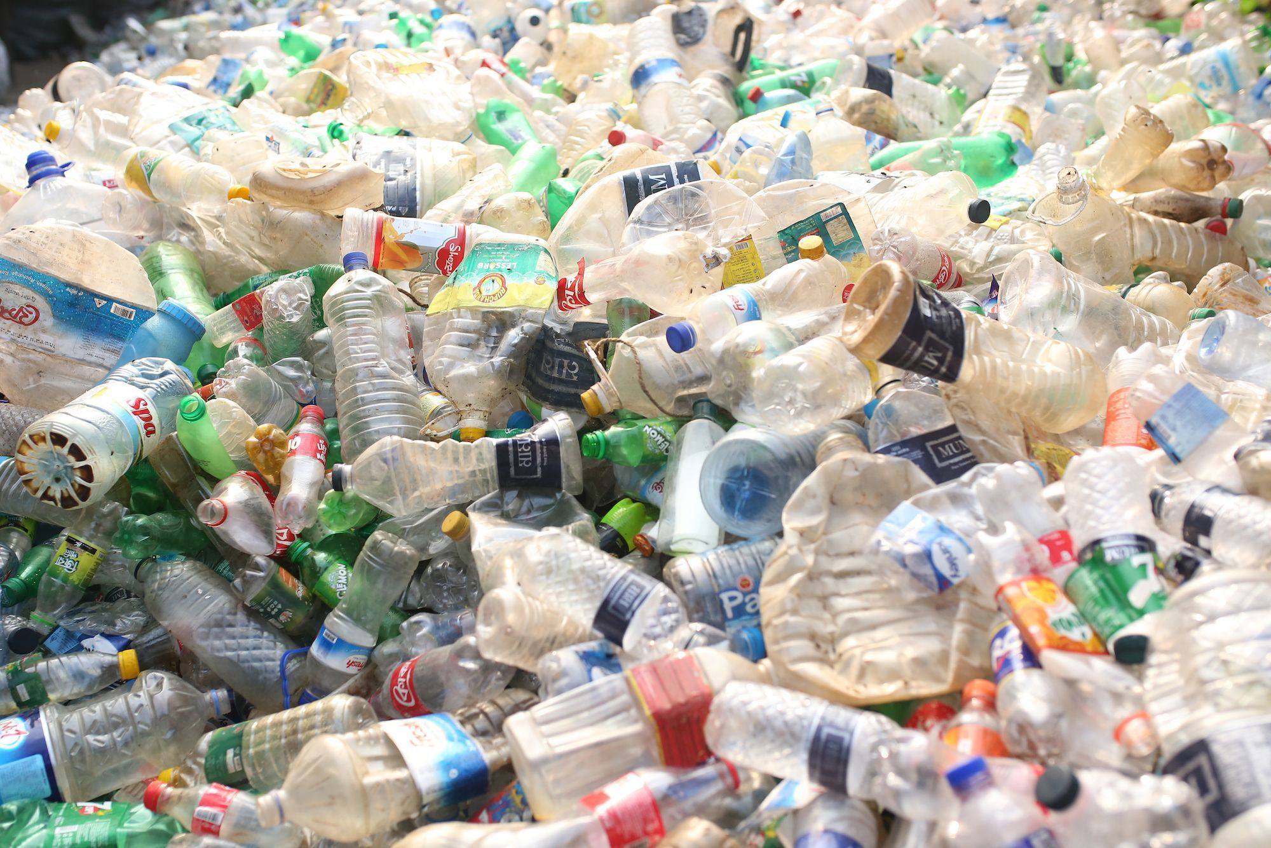
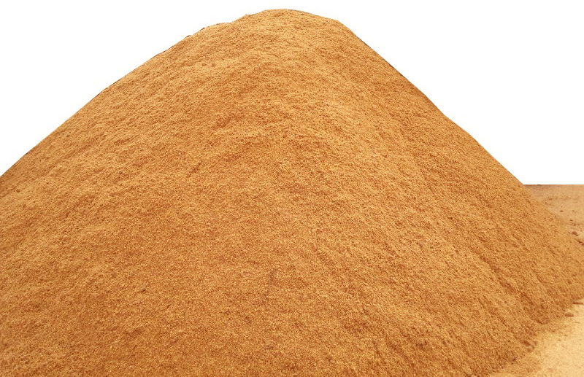
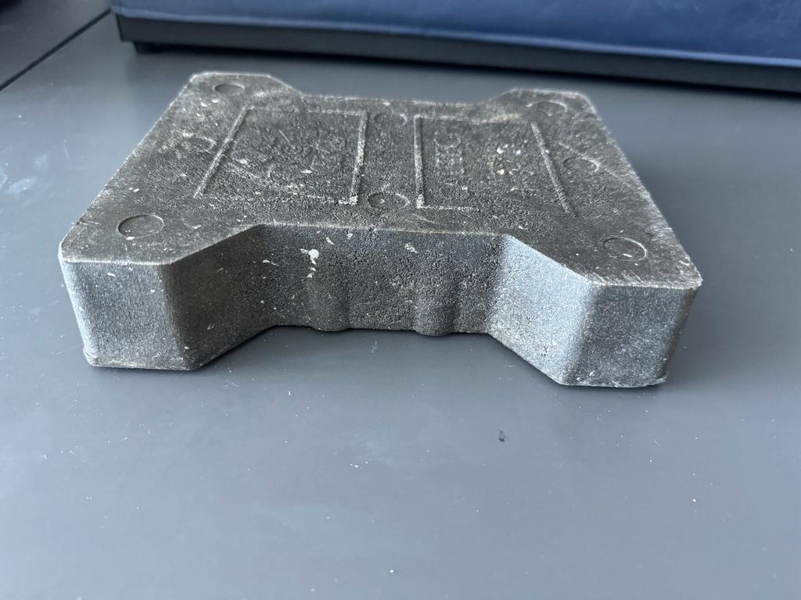
Introduction (continued)
Electricity
Electricity and Sand
Hydraulic fluid and electricity
Water
Mixed plastic waste (PP, PET, PE, PS, PVC)
Shredding
Melting (extrusion at 180-270C)
Molding (hydraulic press)
Cooling (curing)
Blocks
Particulate matter (PM)
VOCs, PM
VOCs
Wastewater
Figure: Manufacturing process of plastic paver blocks
+
Waste plastics
Sand
Plastic blocks

Slide 4
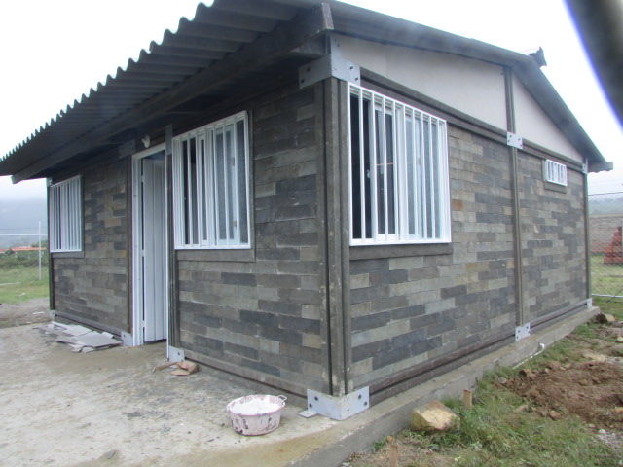
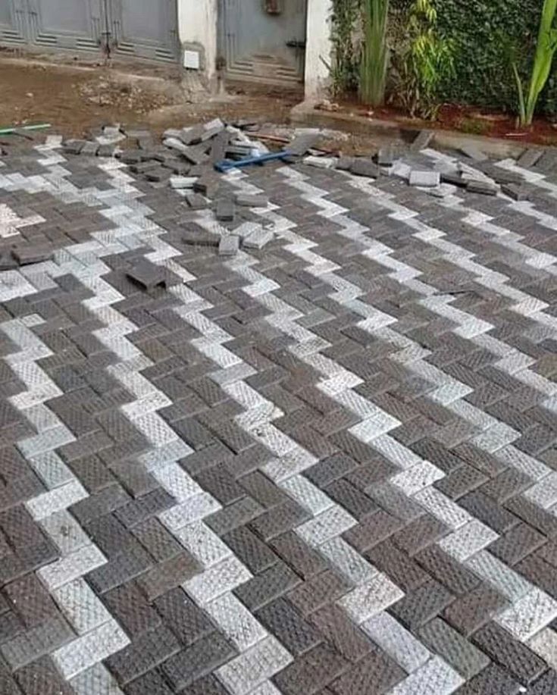
Introduction (continued)
These blocks produced are used to build low-income houses, pave yards and walkways
Plastic blocks being put in use to build houses in costa-Rica
Plastic paver blocks being put in use to pave yards in Kenya

Slide 5
2- Methods
Functional unit and system boundaries
Functional unit: Manufacturing of paver blocks to cover or pave 1m^2 land area.
About 400 plastic paver blocks are needed
Total mass is about 90kg
Dimensions:50 x 50x 50mm3
System boundaries: Cradle to use
Energy
Energy
Transportation
Extraction of raw materials
Manufacturing
Distribution
Use
Waste
Waste
Figure: system boundaries of the LCA, from cradle to use

Slide 6
Methods (continued)
The impact assessment was conducted based on the ReCiPe Midpoint (E) V1.13 methods,
Impact categories analyzed: Climate Change Impact, Terrestrial Acidification, Freshwater Eutrophication, Human Toxicity, ecotoxicity and particulate matter formation
Information used in this study was gotten from my research and related literature (Goyal et al., 2023)
The life cycle inventory for manufacturing plastic paver blocks
Input | Quantity | Unit
Waste plastic | 22.5 | kg
sand | 67.5 | kg
water | 20 | kg
Electricity for shredder | 2.6 | MJ
Electricity for extruder | 30 | MJ
Electricity for press | 25 | MJ
The activities of the LCA and values are found on the excel sheet, which is imported in the code

Slide 7
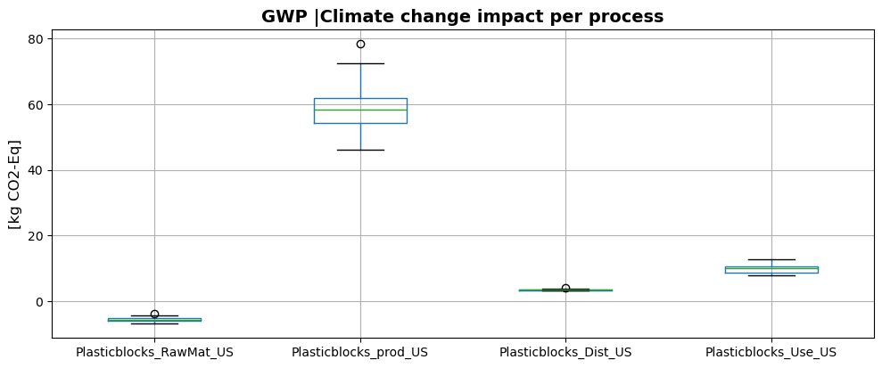
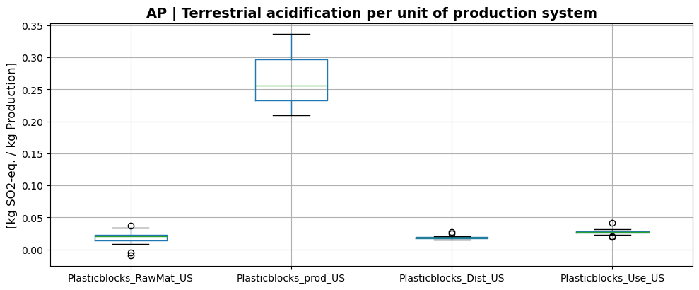
3- Results
Figure: The percentage contribution of the different processes to the Climate change
Figure: The percentage contribution of the different processes to the terrestrial acidification

Slide 8
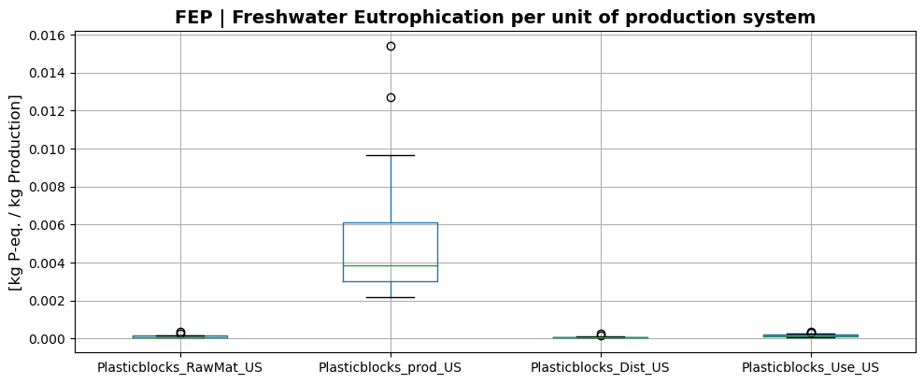
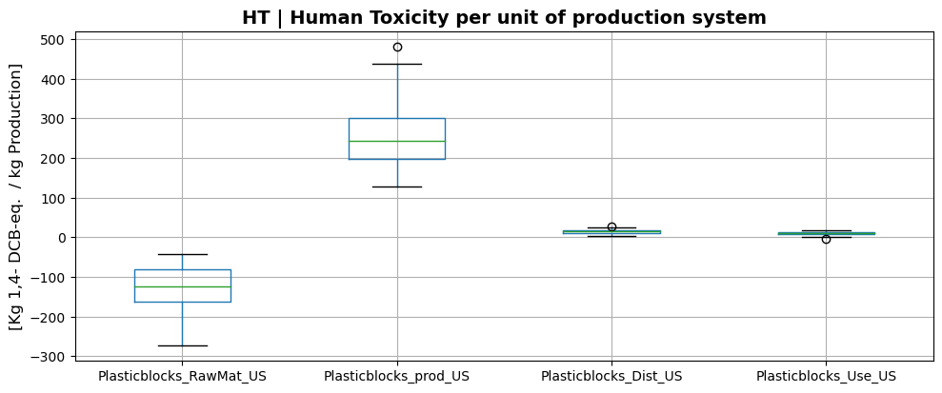
Results (continued)
Figure: The percentage contribution of the different processes to freshwater eutrophication
Figure: The percentage contribution of the different processes to the Human toxicity

Slide 9
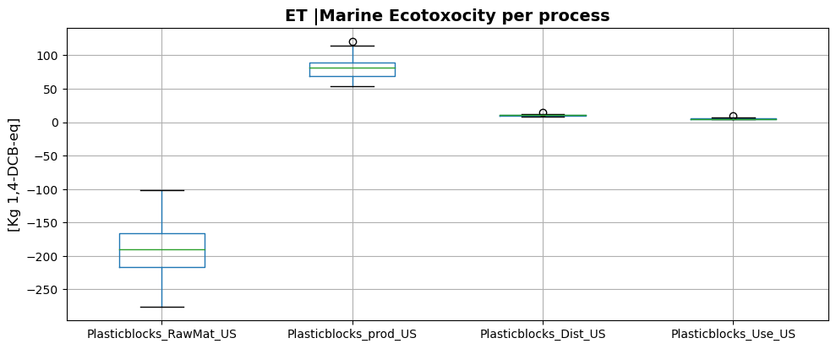
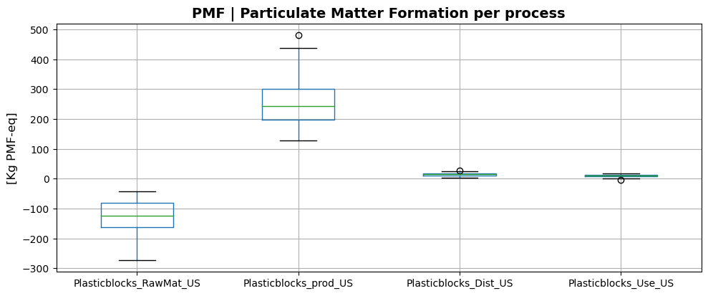
Results (continued)
Figure: The percentage contribution of the different processes to the ecotoxicity
Figure: The percentage contribution of the different processes to the particulate matter formation

Slide 10
Results (continued)
Table: The percentage contribution of the different processes to the different impact indicators
Impact | Raw material | Production | Distribution | Use
GWP | Negative | 81% | 4.78% | 13.57%
AP | 5.73% | 80.06% | 5.73% | 8.52%
FEP | 1.96% | 94.04% | 1.20% | 2.84%
HT | Negative | 91.55% | 4.90% | 3.54%
ET | Negative | 83.46% | 10.79% | 5.74%
PMF | Negative | 87.72% | 5.15% | 7.13%

Slide 11
4- Conclusion
The production operation contributes the highest to all the impact indicators, implying it pollutes the more.
Environmental emissions should be minimized at this stage of the LCA
Raw material extraction contributes the least which means the fact that plastic waste is being collected and recycled is a plus.

Slide 12
THANK YOU

